Slide 1


Polaroid
Out-Of-Home, Direct Mail, Promotional Products
Abigail Jokela And Carlene Macgregor

Slide 2
Out of Home Ads

Slide 3
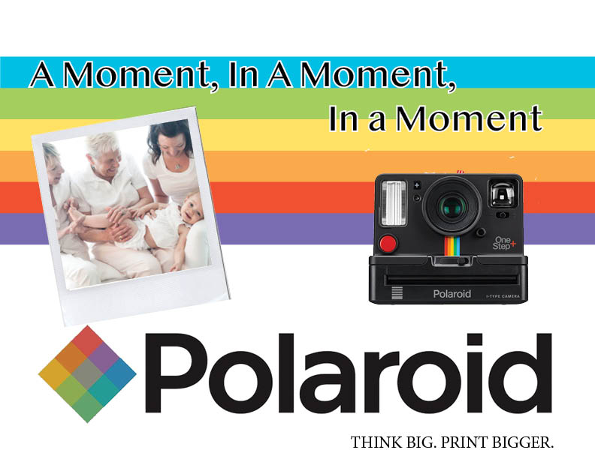
Out of Home Ad
What: Billboard
Why: Billboards are a great way to reach travelers, travelers seek memories, Polaroid helps people cherish those moments.
Benefit: Large Highways connect travelers to their destinations. Billboards are large enough to be seen and attract attention.
Cost:
  Wisconsin (4 Weeks) $250
  New York (4 Weeks) $14,000
  https://www.howmuchisit.org/billboard-advertising-cost/

Slide 4
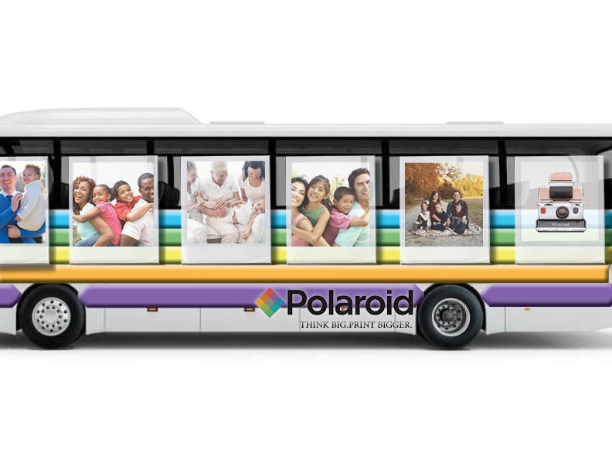
Out of HOME AD
What: King/Queen or Full Wrap Bus Advertisment
Why: They can't be ignored and plenty of all target segments use city buses.
Benefit:
  Attention-Drawing, Varied Audience, & Exclusitivity in marketing space
  A Full Wrap Ad ranges of 50,000 to 100,000 impressions per ad per day.
Cost:
  King (4 Weeks) $150-$950
  Queen (4 Weeks) $150-450
  Full Wrap (4 Weeks) $2,500-$4,500
  Minimum of 15 to 100 ads per month, depending on the medium, timing and market.
https://www.entrepreneur.com/article/76826
https://www.bluelinemedia.com/bus-advertising/bus-exterior#

Slide 5
Direct Mail Promotions

Slide 6
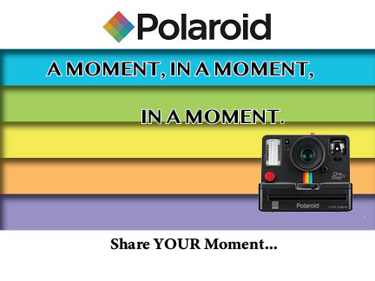
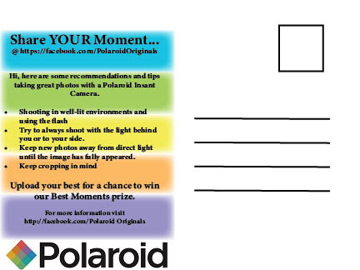
DIRECT mail
What: Post Card Contest
Why: Reaches the demographics and geographic locations you want.
Benefit: This size allows the postcards to be sent with the cheaper first-class postcard rate. Oversized postcards can have a higher visual impact, though they are more expensive to mail.
Cost: Most postcards fall in the range of 50 cents to $1 each, including postage. Many companies offer volume discounts for large orders. For example, a 4" X 6" postcard might cost $.70 if you order 1,000 but only $.50 if your order 5,000.
https://www.photocontestinsider.com/polaroid-photography-tips-tricks/
https://www.costowl.com/b2b/direct-mail-postcards-cost.html

Slide 7
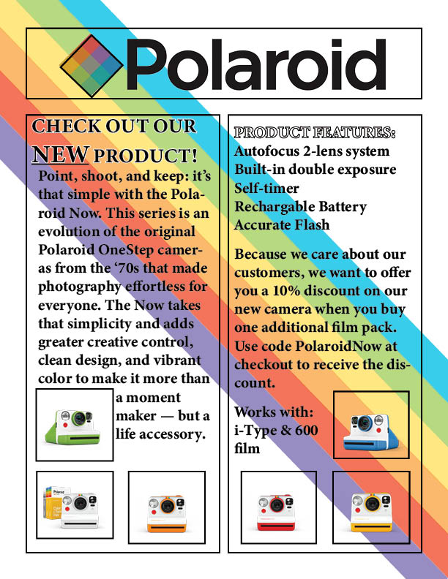
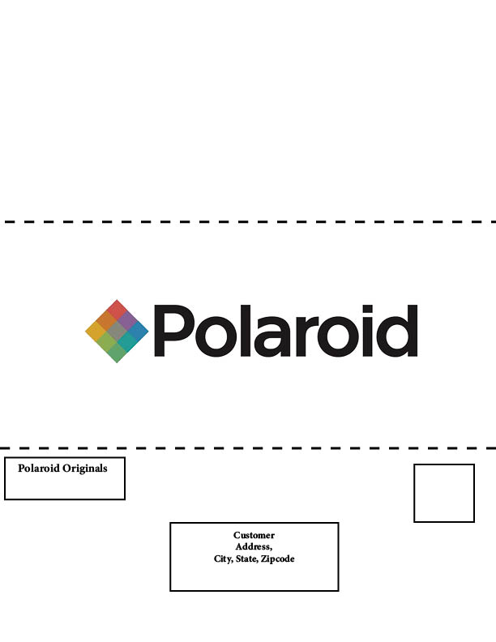
Direct mail
What: Newsletter
Why: Newsletters are most often sent to existing customers to keep them informed about updates, news, and sales.
Benefit: Fairly inexpensive to print and mail. Reach target market of Baby Boomers because the majority are home owners.
Cost:
  2 color inside – 2 color outside
  Vellum on both sides – finish size 8.5 x 5.5 after folding from 11 x 17
  Printed on standard white paper (60# book)
  Bulk mailed nation wide (postage may be less if you have more density)
  Layout and design for News Letter: $100
  Purchase Stock Photography: $50 each photo
  Copy Writer $100 – $200 Per Article
  TOTAL: For 5,000 units to be mailed the total cost would be $2,475
  http://www.mailingjet.com/direct-mail-costs/newsletter-cost
  https://www.saltlakemailing.com/mailing/types-direct-mail/

Slide 8
Promotional Products

Slide 9
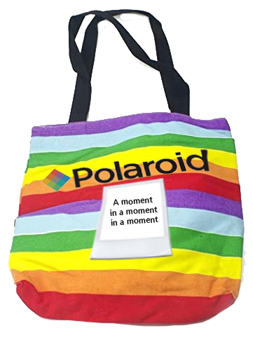
Promotional Products
What: Tote ​Cotton Sheeting​
15-1/2" x 15" - Full Color​
​Why: Everybody needs totes​
Benefit: Reminds buyers about brand​
Cost:​Bulk 250 Quantity - $2.39 ea.
(Total $579.50)​ Set-up included
https://www.4imprint.com/product/120982-64G/Clipster-USB-Drive-64GB

Slide 10
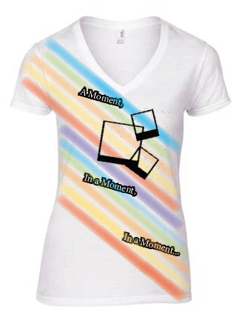
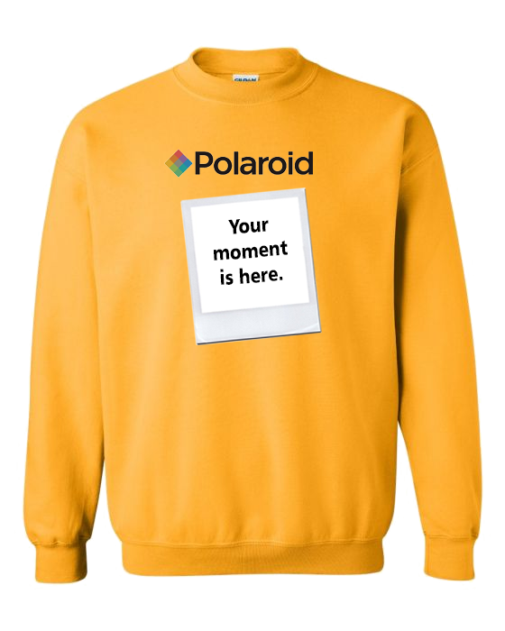
Promotional products
What: Apparel​
Why: Clothes are awesome promotional items​
Benefit: T-Shirts are a great way of advertising. Not only are you making money off the purchase of the T-shirt, but you are making money off the "free" advertising people are doing for you every time they wear your shirt​
Cost: $19.50 per (Sweat shirt or T-shirt) per 300 bulk order
https://www.4imprint.com/hot/par/193

Slide 11
References
BUS EXTERIOR ADS. (2020). RETRIEVED APRIL 14, 2020, FROM HTTPS://WWW.BLUELINEMEDIA.COM/BUS-ADVERTISING/BUS-EXTERIOR#​
COSTOWL.COM. (2020). RETRIEVED APRIL 14, 2020, FROM HTTPS://WWW.COSTOWL.COM/B2B/DIRECT-MAIL-POSTCARDS-COST.HTML​
DONCUS, M. (2017, JANUARY 25). POLAROID PHOTOGRAPHY TIPS AND TRICKS. RETRIEVED APRIL 14, 2020, FROM HTTPS://WWW.PHOTOCONTESTINSIDER.COM/POLAROID-PHOTOGRAPHY-TIPS-TRICKS/​
HOTTEST PRODUCTS. (N.D.). RETRIEVED APRIL 14, 2020, FROM HTTPS://WWW.4IMPRINT.COM/HOT/PAR/193​
HOW MUCH DOES BILLBOARD ADVERTISING COST? (2018, AUGUST 8). RETRIEVED APRIL 14, 2020, FROM HTTPS://WWW.HOWMUCHISIT.ORG/BILLBOARD-ADVERTISING-COS​
KOBLISKI, K. J. (2005, MARCH 18). THE ADVANTAGES OF TRANSIT ADVERTISING. RETRIEVED APRIL 14, 2020, FROM HTTPS://WWW.ENTREPRENEUR.COM/ARTICLE/76826​
NEWSLETTER COST: PRICING INFORMATION FOR SENDING NEWSLETTERS. (2020). RETRIEVED APRIL 14, 2020, FROM HTTP://WWW.MAILINGJET.COM/DIRECT-MAIL-COSTS/NEWSLETTER-COST​
POLAROID NOW INSTANT CAMERA WITH FILM – POLAROID US. (N.D.). RETRIEVED APRIL 14, 2020, FROM HTTPS://US.POLAROID.COM/COLLECTIONS/NOW-3FILM-BUNDLE​
TYPES OF DIRECT MAIL. (N.D.). RETRIEVED APRIL 14, 2020, FROM HTTPS://WWW.SALTLAKEMAILING.COM/MAILING/TYPES-DIRECT-MAIL/

